Slide 1

Introducing KUBESTELLAR: making multi-cloud easier

Slide 2


Andy Anderson
github.com/kubestellar/kubestellar
Research Engineering Manager
Member: TAG Runtime - WG IoT Edge
IBM Research
andrew.anderson@ibm.com
@clubanderson
Notes:
Who am I? I work on open source Istio. I am on the Technical Oversight Committee as well the the Test and Release WG Lead. I also help with documentation PRs. Currently, I am the number 2 contributor for Istio with nearly 20,000 contributions.

Slide 3

Commercial Break
Notes:
This is KubeCon/Cloud NativeCon, so I need to show the CNCF landscape picture.

Slide 4
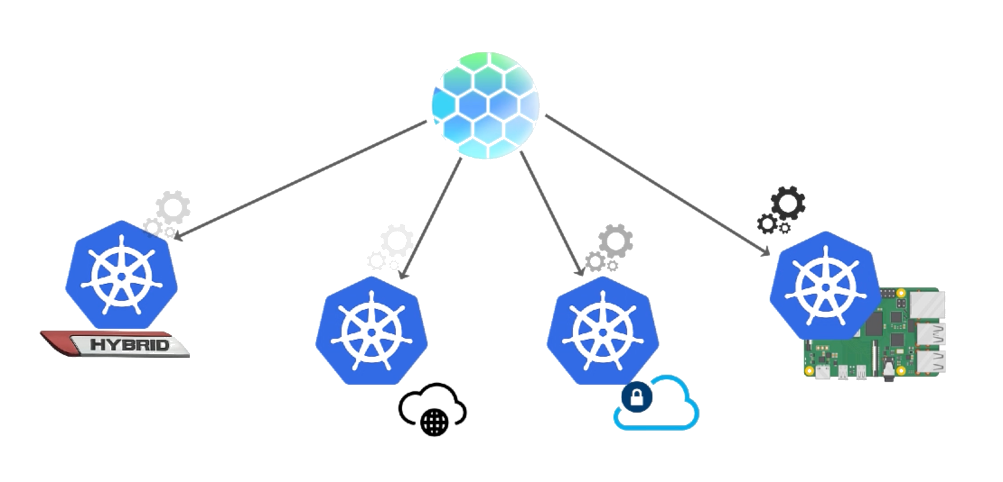

KUBESTELLAR treats multiple Kubernetes cluster as one
Hybrid, Public, Private, Edge - Create One Configuration, Deploy Many
Notes:
There are a lot of technologies and projects, here I highlighted the Service Mesh technology section.

Slide 5

KUBESTELLAR uses standards deployment tools, not bundles
Centrally deploy Kubernetes resources across multiple clusters
Use standard deployment tools (kubectl, helm, ArgoCD, Flux) no bundling required
Discover objects created on edge clusters
Make disconnected cluster operation possible
Designed for scalability with 1:many and many:1 scenarios
Modular design to ensure compatibility with CNCF tools
Notes:
There are a lot of technologies and projects, here I highlighted the Service Mesh technology section.

Slide 6
KUBESTELLAR virtual clusters (Spaces) are our secret
KubeStellar uses lightweight virtual clusters (Spaces) that run inside the KubeStellar hosting cluster
Standard Kubernetes clusters have 2-300 api-resources, KubeStellar Spaces have only 40
Fewer api-resources mean resources remain denatured – they do not expand into other resources like replicasets, pods, etc.
Denaturing is the key to accepting native, unbundled Kubernetes resources as input
Unbundled resources are the preferred output of most CNCF tools making KubeStellar use and integration easy
Kubernetes | KUBESTELLAR
kubectl api-resources | wc –l 281 | kubectl api-resources | wc –l 40
Notes:
There are a lot of technologies and projects, here I highlighted the Service Mesh technology section.

Slide 7
Thank you
Andy Anderson
IBM Research Engineering Manager
—
andrew.anderson@ibm.com
@clubanderson
KUBESTELLAR.IO/JOINUS

